Slide 1
CSG2H3 Object Oriented Programming
MVC

Slide 2
Architecture vs Pattern ?
Define Clear Responsibilities, communication and loose coupling between the three primary components of most user systems
VIEW
[GUI]
CONTROL
[Event-Handler]
MODEL
[Data /Proses]

Slide 3
About MVC [1]
The model-view-controller (MVC) architecture provides a set of design patterns that help you separate the areas of concern involved in building and running a GUI-based application.
The model encapsulates the business logic and persistence code for the application. The model should be as view-technology-agnostic as possible.

Slide 4
About MVC [2]
The view should display model objects and contain presentation logic only. There should be no business logic or controller logic in the view
The controller (along with its attending logic) acts as the mediator between the view and the model. The controller talks to the model and delivers model objects to the view to display.

Slide 5

Note
MVC is a software architectural pattern
A paradigm
An approach to structuring the software maintainable and flexible program code

Slide 6

Note
There’s a lot of approach to achieve it according to what programming language and coding style of the programmer
MVC coding style might differ from one programmer to another
The example here is only one of those

Slide 7

MVC elements
POJO Class
Application Class
View Class
Controller Class

Slide 8

Model Class
POJO class
Plain Old Java Object
According to class diagram
Application Class
Contains business process functions
as defined in use case diagram
Where the other object lives

Slide 9
View Class
Purely to receive input and display output
No business or logic process
Unless it is closely related to the display procedure (presentation logic)
Controller Class
Connect the view to the application
The controller always selects the next view.

Slide 10
MVC Approach : Driver Console
POJO class
Model
Driver Console
Application class
Model
Model
VIEW
CONTROL
MODEL

Slide 11
MVC Approach : 1 view - 1 controller
Controller can be inner class of the view
POJO class
Model
View
Controller
Application class
Model
Model
VIEW
CONTROL
MODEL

Slide 12
MVC Approach : n view - n controller
The application object is passed from one view to another
POJO class
View 1
Controller 1
Model
View 2
Controller 2
Application class
Model
View n
Controller n
Model
VIEW
CONTROL
MODEL

Slide 13
MVC Approach : n view - 1 controller
Interface View
POJO class
View 1
Model
View 2
Controller
Application class
Model
View n
Model
VIEW
CONTROL
MODEL

Slide 14

Tutorial MVC

Slide 15
POJO Example : Employee - Manager
Employee
idEmployee : String position : int birthdate : Date salary : double / age : int + iterator : static int
+ Employee( name, birthdate, position ) + setAge() + setSalary() + toString() : String + setter getter
Manager
listSubordinate :Employee[] numSubordinate : int bonus : int + iterator : static int
+ Manager( name, birthdate, position, bonus ) + getSalary() + addSubordinate( e : Employee ) + getSubordinate( id ) : Employee + removeSubordinate( id ) + getSubordinateList() : String[] + toString() : String + setter getter

Slide 16
Application Class
POJO class
Application
listEmployee : ArrayList<Employee>
+ Application() + insertEmployee( name, birthdate, position ) + insertManager( name, birthdate, position, bonus ) + getEmployee( id ) : Employee + removeEmployee( id ) + promoteEmployee( id, bonus ) + assignmanager( idManager, idEmployee ) + removeAssign( idManager, idEmployee ) + viewEmployee() + getListAllEmployee() : String[] + getEmployeeList() : String[] + getManagerList() : String[]
Employee
Manager

Slide 17

Model Class

Slide 18
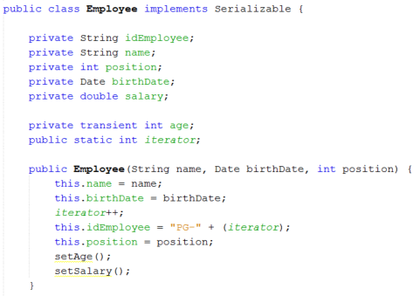
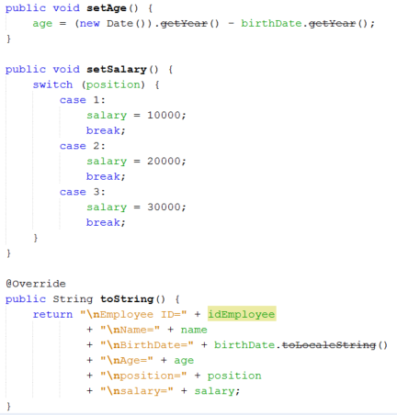
Employee class

Slide 19
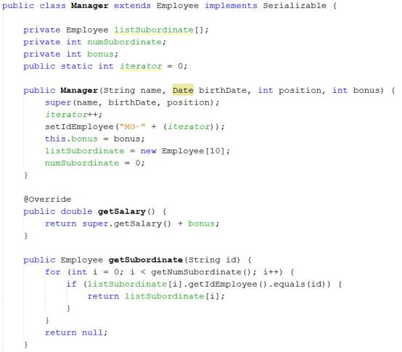
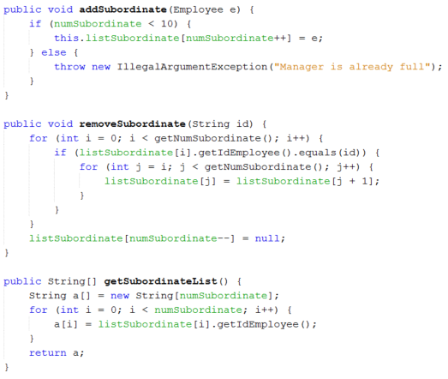
Manager class

Slide 20

Application Class

Slide 21
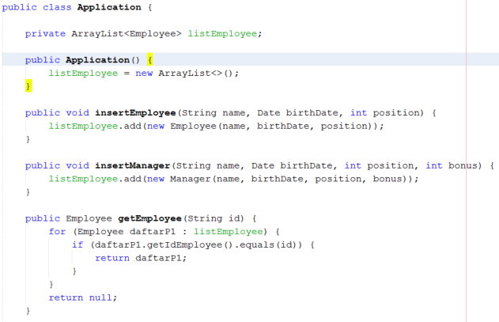
Application Class

Slide 22
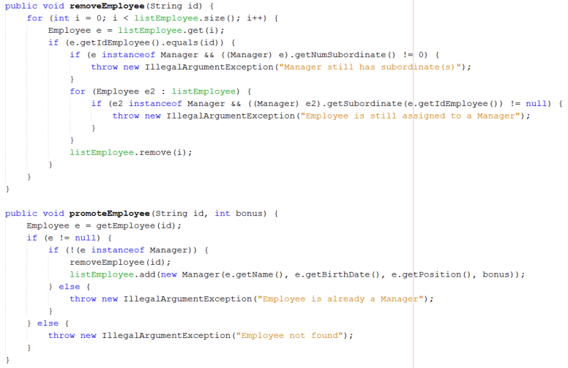
Application Class

Slide 23
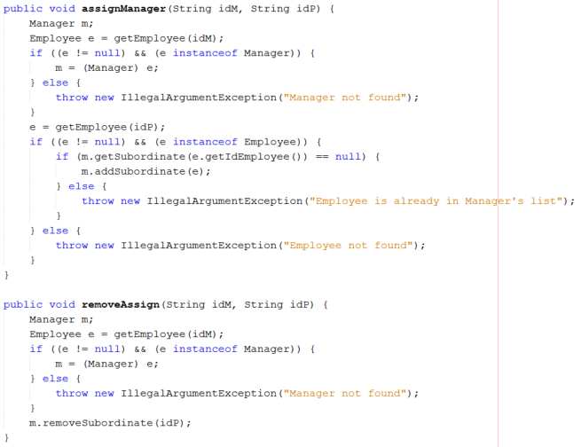
Application Class

Slide 24
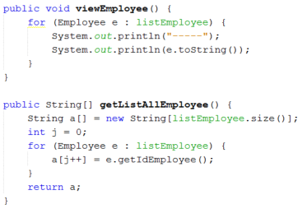
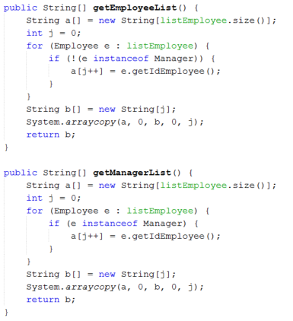
Application Class

Slide 25
Application Class : additional
Create class to save the object to file or database
In this example, we use FileIO class to write/read object into a file
Write/read string to file
public void saveLog(String s, String file) throws IOException
public String readLog(String file) throws FileNotFoundException, IOException
Write/read object to file
public void saveObject(Object o, String filename) throws FileNotFoundException, IOException
public Object getObject(String filename) throws IOException, ClassNotFoundException

Slide 26
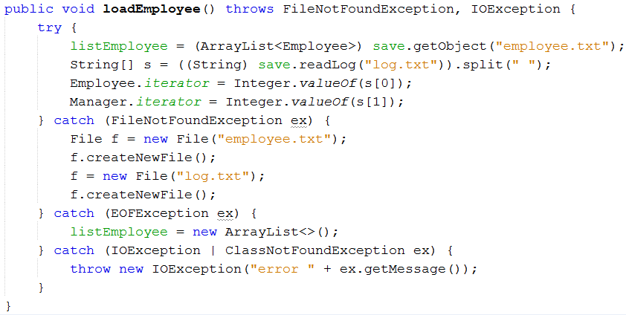
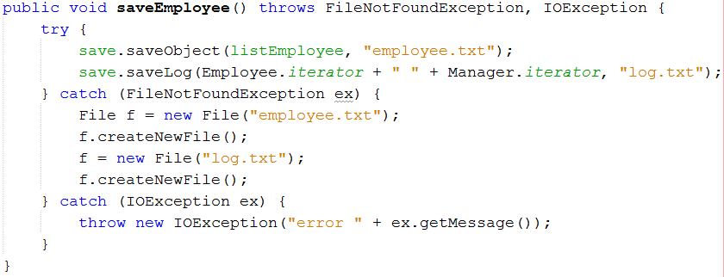
Application Class : additional

Slide 27

Console-based Application

Slide 28
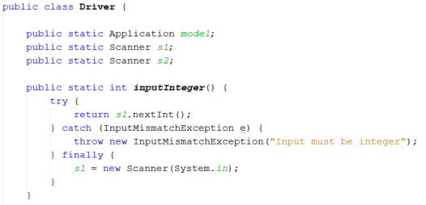
Driver Application class

Slide 29
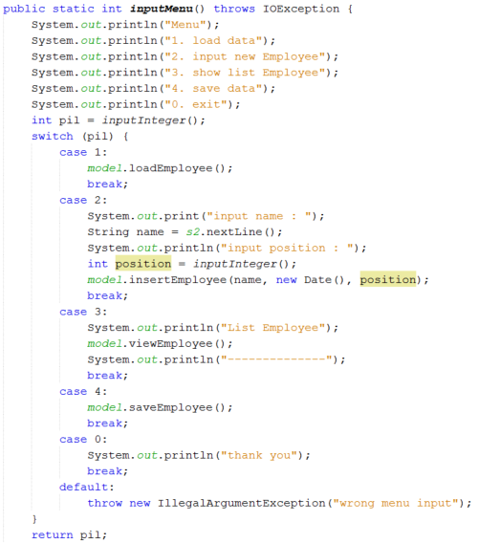
Driver Application class

Slide 30
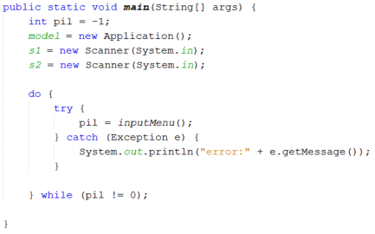
Driver Application class

Slide 31
Question?

Slide 32
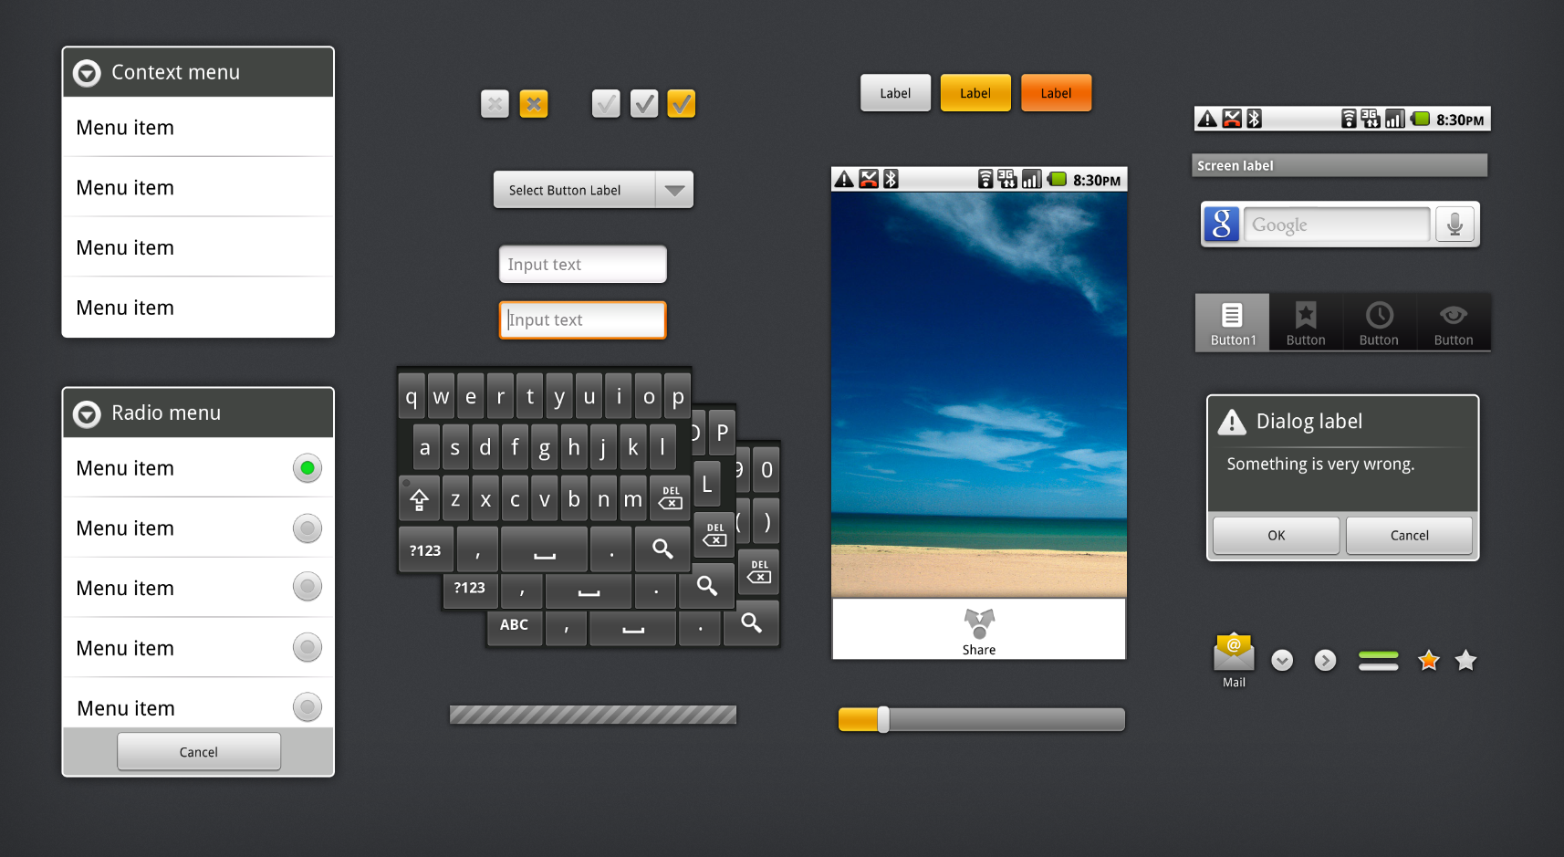
GUI Application

Slide 33
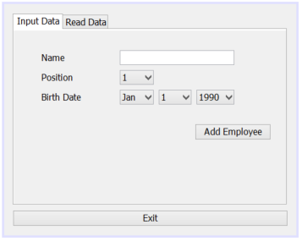
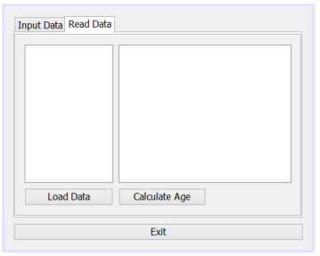
View Employee GUI
Create a desirable GUI design
Give each component a respective variable name

Slide 34
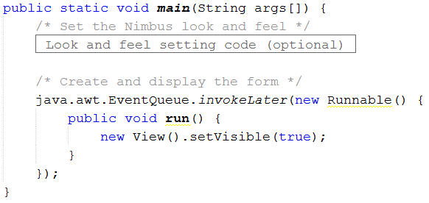
View Employee GUI
If you’re using an IDE (such as NetBeans), you might want to remove (delete) the main method first

Slide 35
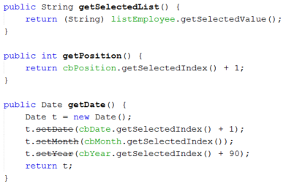
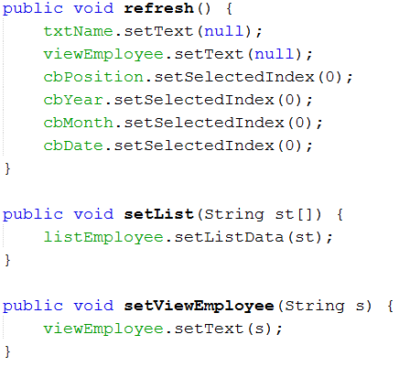
View Employee GUI
Create a method to perform input-output operation from the components

Slide 36

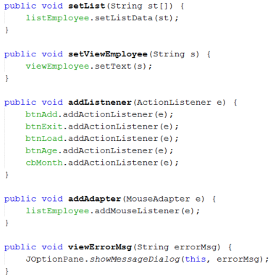
View Employee GUI
Create a method to add Event Listener to the action component
Add ActionListener to buttons to listen action when the button pressed
Add MouseAdapter to list to listen action when the list selected

Slide 37

View Employee GUI
Additional : Create a method to view message such as error message

Slide 38
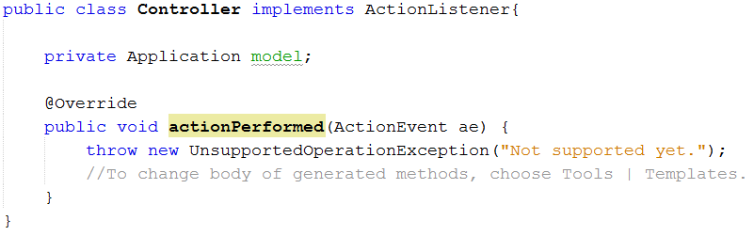
View Employee : Controller
Create inner class Controller implements ActionListener
Can be made private
Add variable model Application

Slide 39
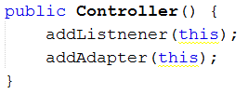
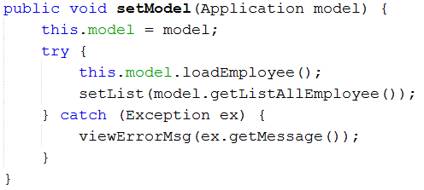
View Employee : Controller
create Constructor to call method addListener and addAdapter from the GUI
Create method to set the Model Application
Load the data after setting the model

Slide 40
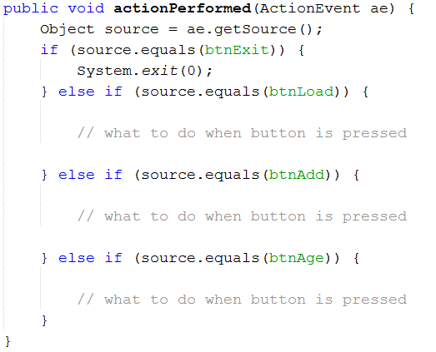
View Employee : Controller
Define the business process when the button pressed in actionPerformed method

Slide 41
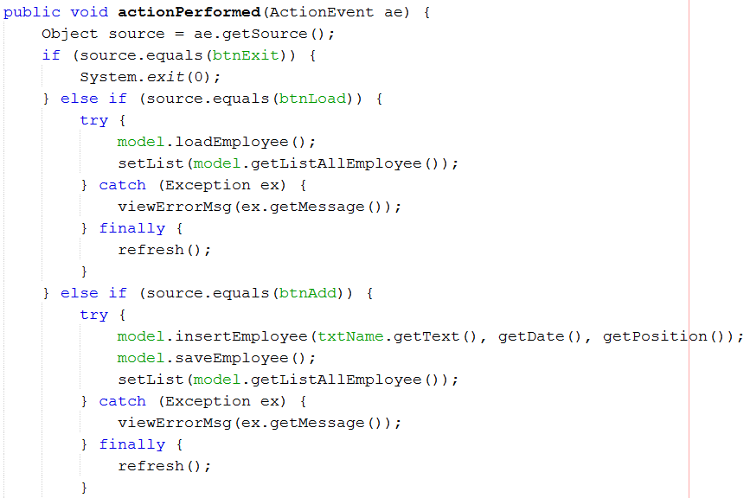
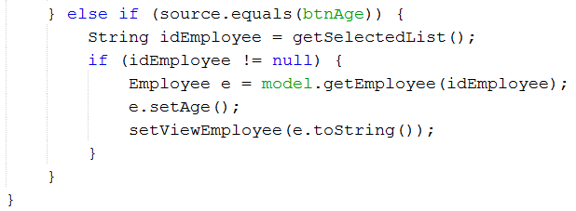
View Employee : Controller

Slide 42
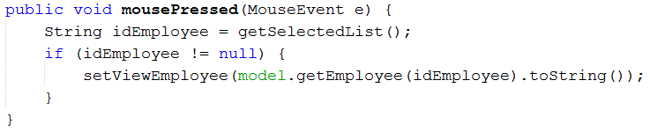
View Employee : Controller
Define the business process to view the detail of selected Employee

Slide 43
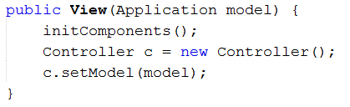
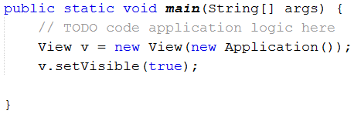
View Employee : Controller
Add/change a constructor so when the view will instantiate the controller on call
Run the app by calling the View on driver class

Slide 44
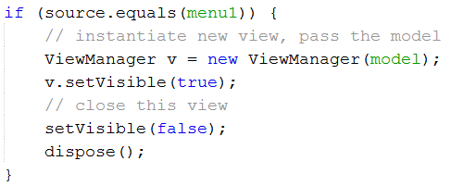
Move from one view display to another
Instantiate the new view
Pass the model application object to the new view
Close the current view
Example :

Slide 45
Question?

Slide 46
Credits
Music : Yonezawa Madoka - Oui! Ai Kotoba (Instrumental)

